Slide 1
Introduction to Machine Learning. Basic Concepts and Learning.
Instructor: Sabina Umirzakova
sabinatuit@gachon.ac.kr

Slide 2
Agenda
Artificial intelligence
Machine learning
Types of ML
Supervised Learning
Unsupervised Learning
Semi – Supervised Learning
Reinforcement Learning

Slide 3
What you will learn
A degree in this field typically covers how to develop self-learning computer systems by combining algorithms and statistical models. Without accepting instructions from programmers, these computer systems do tasks based on data and self-generated feedback (trial and error).

Slide 4
Why do you need this course
Studying Machine Learning opens a world of opportunities to develop cutting edge applications in various areas, such as cybersecurity, image recognition, medicine, and face recognition.
If you are in search of the most in-demand and most-exciting career in the next few decades, a degree specializing in Machine Learning is a good start.

Slide 5
Lectures
We meet at 10:00 am, every Wed, floor 5, room 508
Read the syllabus and policies carefully
Reading and labs will be posted online

Slide 6
Grading
Attendance | 10%
Midterm Exam | 30%
Assignments | 20%
Final exam | 40%
Homework and Programming projects will be posted online on the class webpage
Those who miss 4 classes will be awarded F

Slide 7

Lab Activity
It will involve:
Applying what we learned in theory
Clean design and coding
Clear documentation

Slide 8
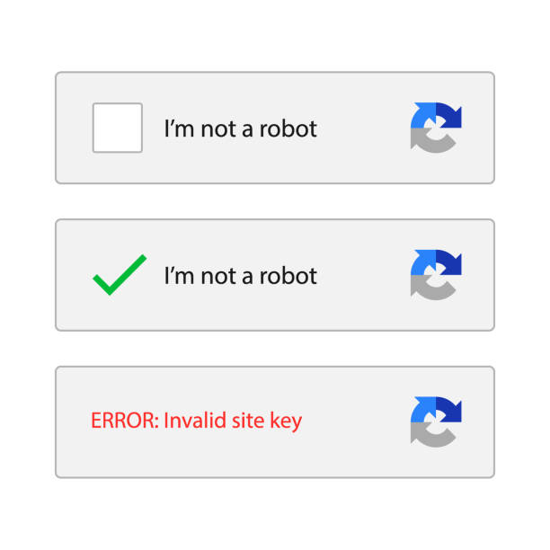
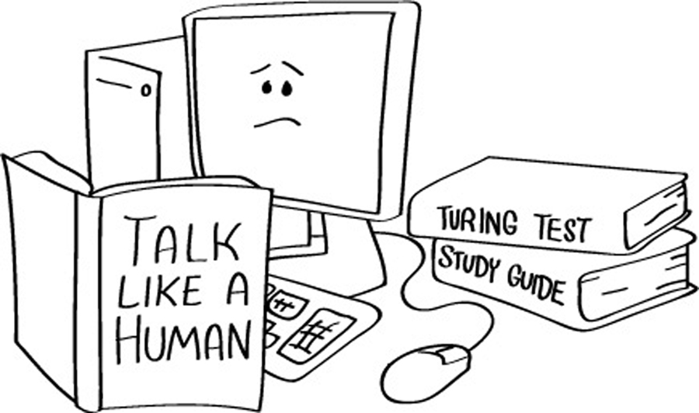
What is artificial intelligence (AI)?
The ultimate goal of artificial intelligence is to build systems able to reach human intelligence levels
ARTIFICIAL INTELLIGENCE DEFINED: FOUR TYPES OF APPROACHES
Thinking humanly: mimicking thought based on the human mind.
Thinking rationally: mimicking thought based on logical reasoning.
Acting humanly: acting in a manner that mimics human behavior.
Acting rationally: acting in a manner that is meant to achieve a particular goal.

Slide 9
Goals of Artificial Intelligence
Replicate human intelligence
Solve Knowledge-intensive tasks
An intelligent connection of perception and action
Building a machine which can perform tasks that requires human intelligence such as:
Proving a theorem
Playing chess
Plan some surgical operation
Driving a car in traffic
Creating some system which can exhibit intelligent behavior, learn new things by itself, demonstrate, explain, and can advise to its user.

Slide 10
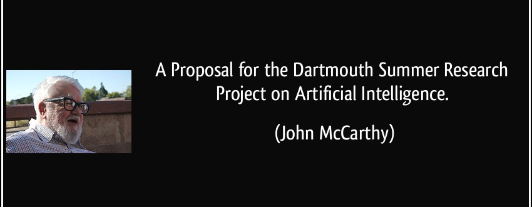
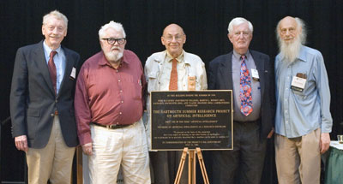
Brief history of AI

Slide 11
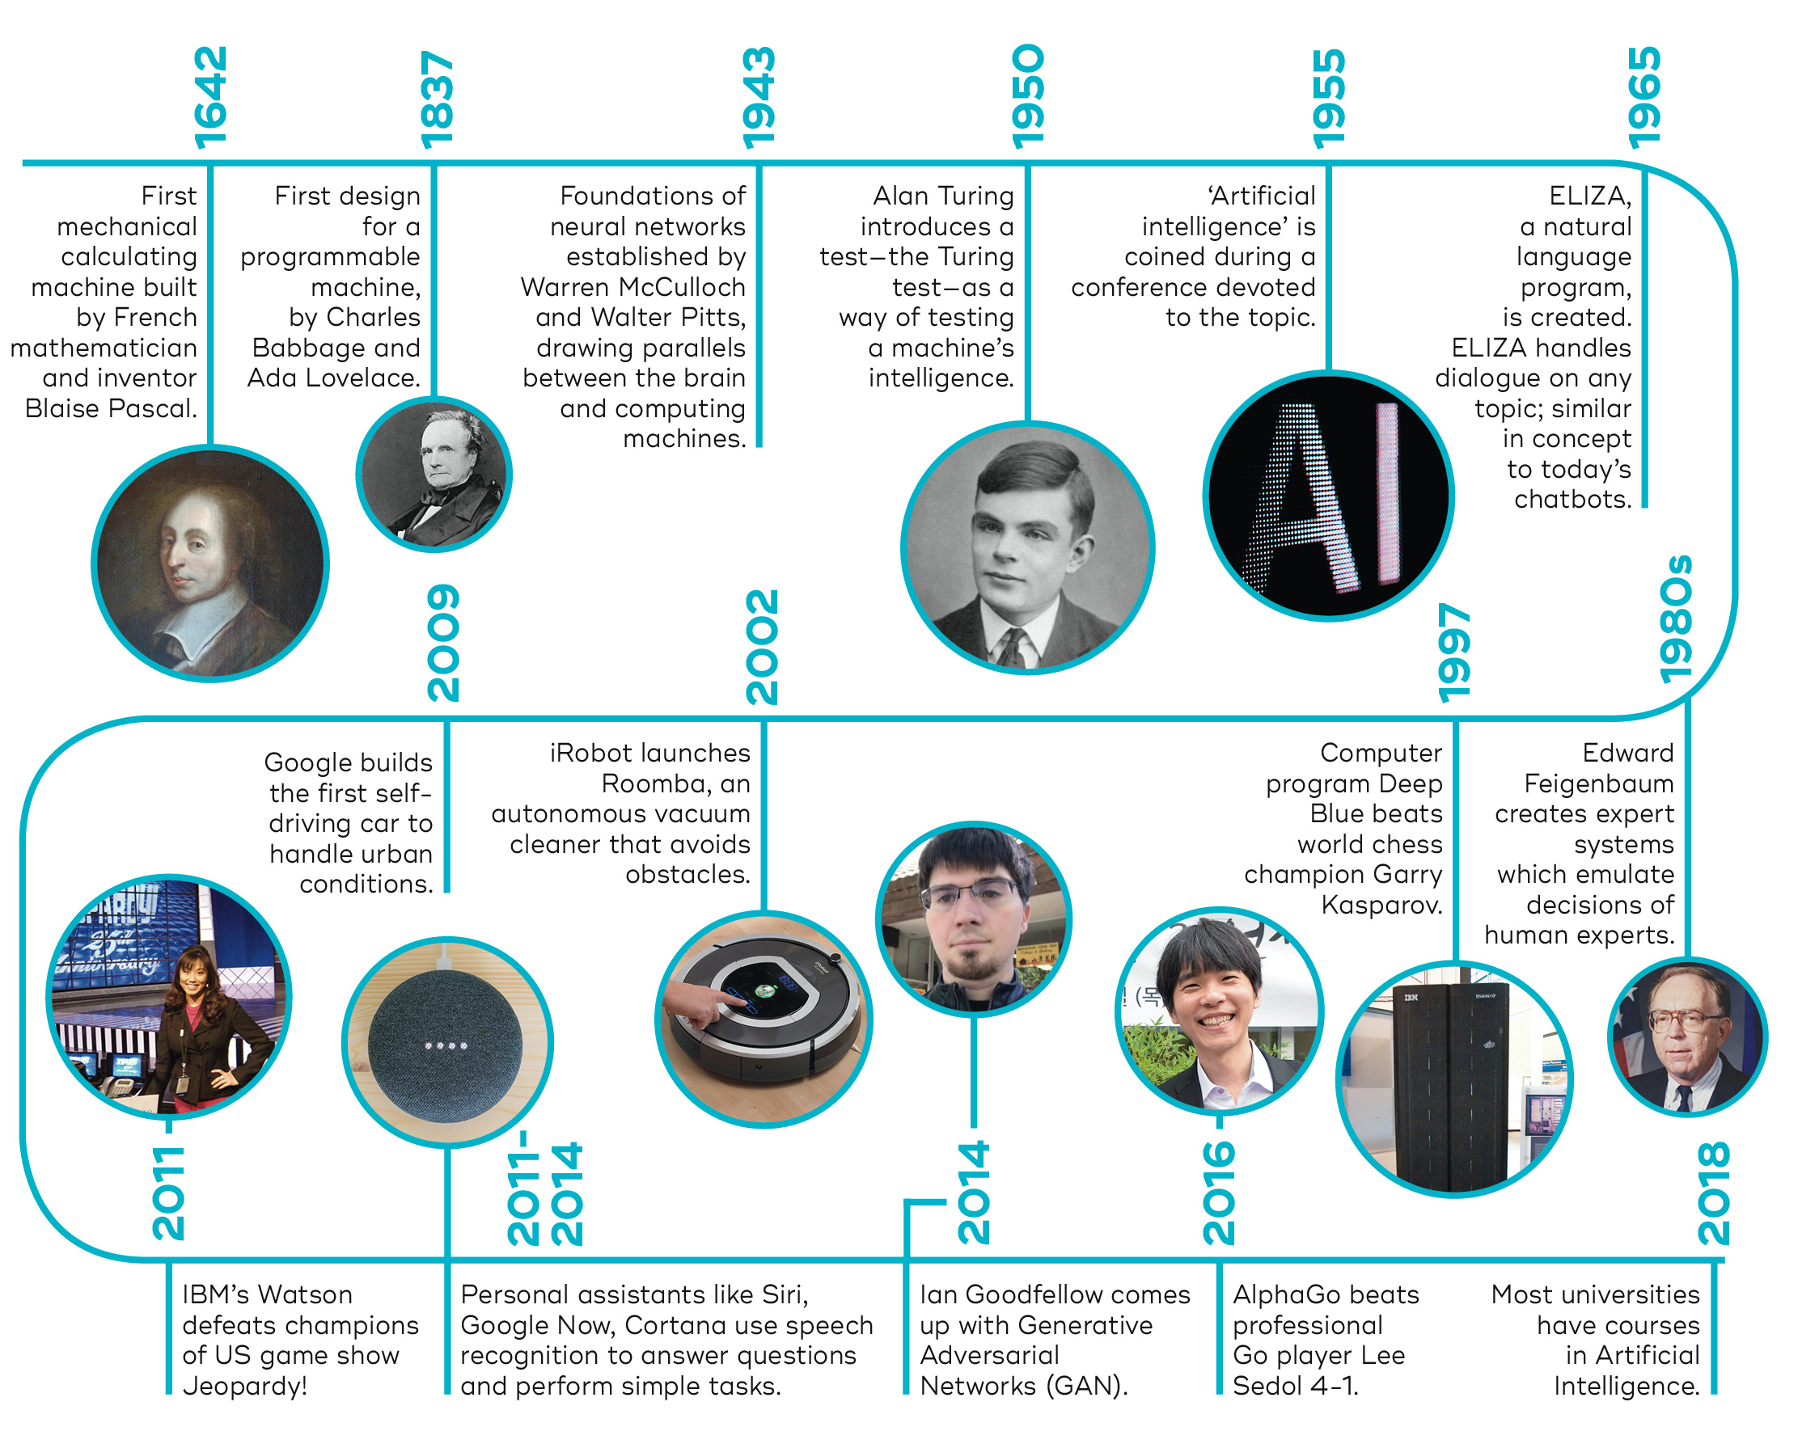
Brief history of AI
https://datalchemy.ai/insights/posts/3-Artificial-Intelligence-Everything-You-Need-to-Know.html

Slide 12
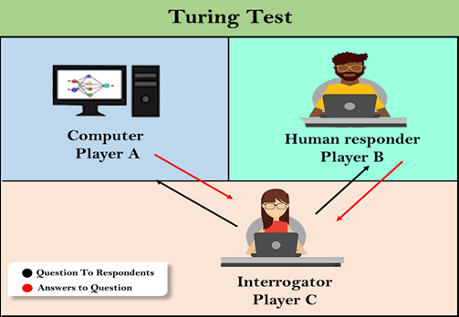
Turing test machine
In this game, if an interrogator would not be able to identify which is a machine and which is human, then the computer passes the test successfully, and the machine is said to be intelligent and can think like a human.
The questions and answers can be like:
Interrogator: Are you a computer?
Player A (Computer): No
Interrogator: Multiply two large numbers such as (256896489*456725896)
Player A: Long pause and give the wrong answer.

Slide 13
Brief history of AI
1960-1980 The First AI Winter
1970 Expert Systems
1987-1993 The Second AI Winter
1990 Conversation with Computers Becomes a Reality (NLP)
1990 Intelligent Agents
1990 Machine Learning
2011 Digital Virtual Assistants and Chatbots

Slide 14
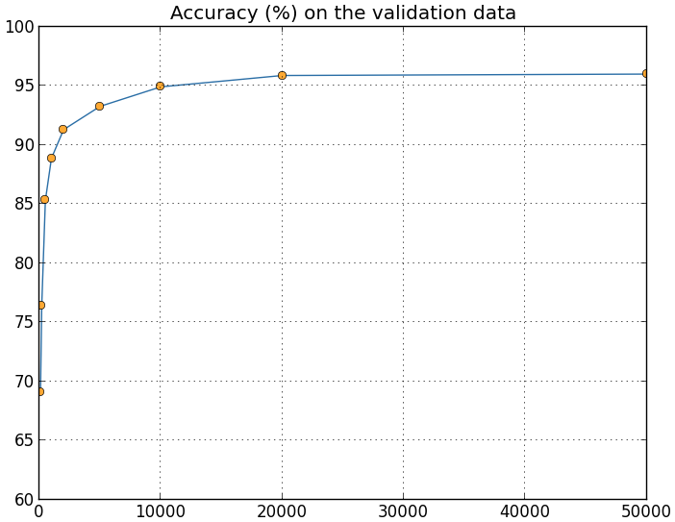
Why are things working today?
More compute power
More data
Better algorithms / models
Accuracy
Amount of Training Data

Slide 15
Advantages of Artificial Intelligence
High Accuracy with less errors
High-Speed
High reliability
Useful for risky areas
Digital Assistant
Useful as a public utility

Slide 16
Disadvantages of Artificial Intelligence
High Cost
Can't think out of the box
No feelings and emotions
Increase dependency on machines
No Original Creativity

Slide 17
Q&A
What is AI?

Slide 18
Q&A
For what used Turing Test

Slide 19
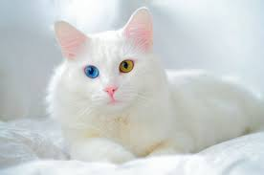
What is Machine Learning
Using data for answering questions
Training
Predicting

Slide 20
What is machine learning (ML)?
Machine Learning – is the scientific study of algorithms and statistical models that computer systems use to learn from observations, without being explicitly programmed
In this context, learning refers to:
recognizing complex patterns in data
making intelligent decisions based on data observations

Slide 21
Programming
Traditional Programming
Data
Computer
Output
Program
Machine Learning
Data
Computer
Program
Output

Slide 22
Programming
Calculator
Calculator
Add
Add
+
++++++++++++
Subtract
Subtract
-
Model
-------------------
Multiply
Multiply
*
************
Divide
Divide
/
///////////////
Rule 1:
Rule 2:
Rule 3:

Slide 23


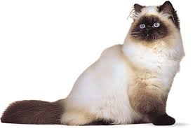
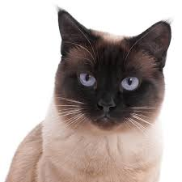
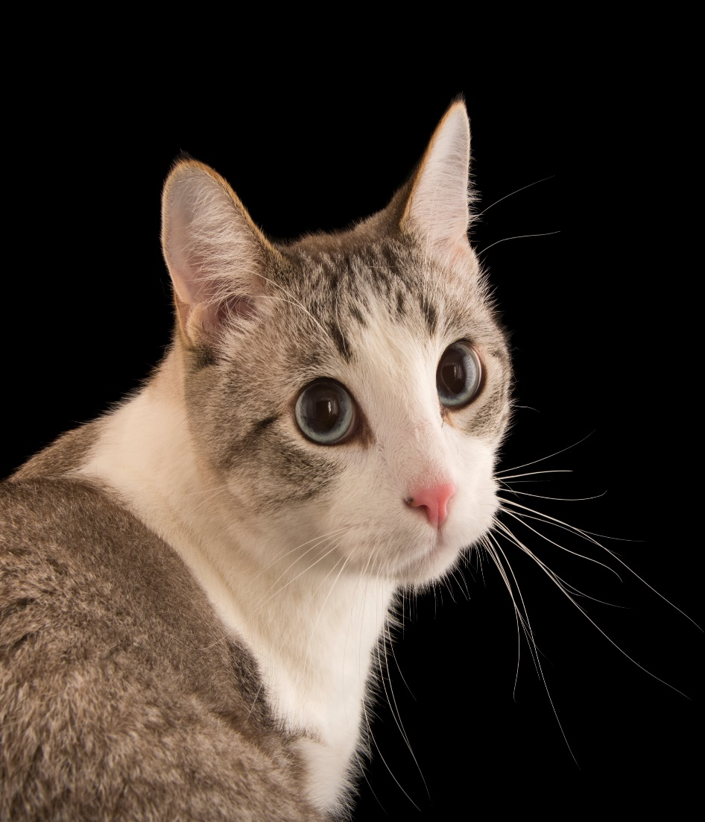
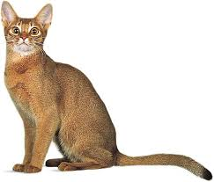
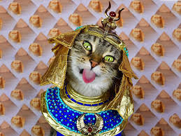


Programming
Recognize cat:
Label: cat
Recognize cat:
R1: If has 2 ears
R2: If has 4 legs
R3: If has 2 eyes
And so on ……..
Cat 99%
Model

Slide 24
What problems solved with machine learning
Identifying Spam
Making Product Recommendations
Image & Video Recognition
Fraudulent Transactions
Virtual Personal Assistant
Customer Service Automation

Slide 25
When to Use Machine Learning
It is important to remember that ML is not a solution for every type of problem. There are certain cases where robust solutions can be developed without using ML techniques. For example, you don’t need ML if you can determine a target value by using simple rules, computations, or predetermined steps that can be programmed without needing any data-driven learning.

Slide 26
When to Use Machine Learning
Use machine learning for the following situations:
You cannot code the rules: Many human tasks (such as recognizing whether an email is spam or not spam) cannot be adequately solved using a simple (deterministic), rule-based solution. When rules depend on too many factors and many of these rules overlap or need to be tuned very finely, it soon becomes difficult for a human to accurately code the rules. You can use ML to effectively solve this problem.
You cannot scale: You might be able to manually recognize a few hundred emails and decide whether they are spam or not. However, this task becomes tedious for millions of emails. ML solutions are effective at handling large-scale problems.

Slide 27
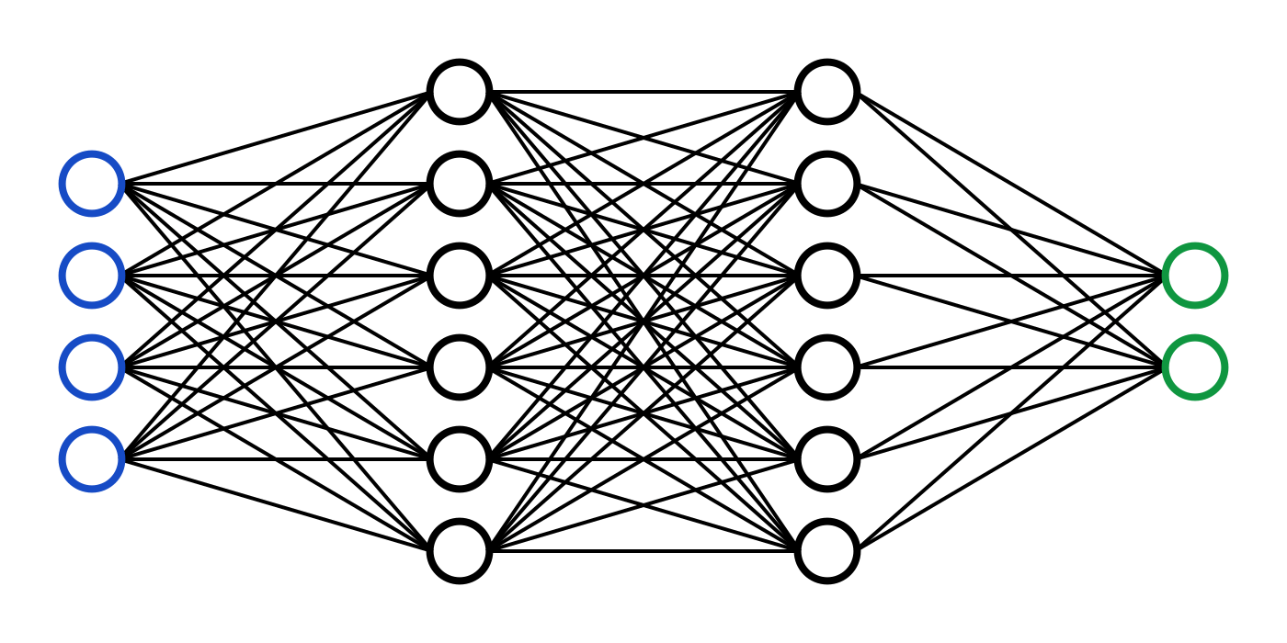
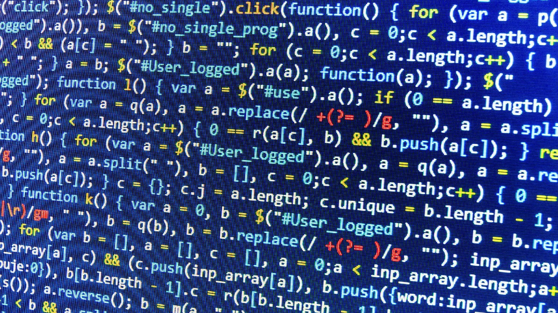
The nature of machine learning
A pattern exists
We cannot express it programmatically
We have data on it

Slide 28
ML representation
Every machine learning algorithm has three components:
Representation / Model Class
Evaluation / Objective Function
Optimization

Slide 29
Where does ML fit in?
Biology
Neuroscience
Applied Math
Machine Learning
Computer Science
Statistics

Slide 30
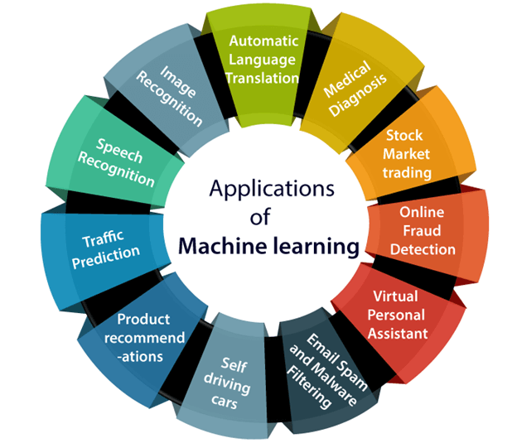
Applications of Machine learning
http://www.test.com/

Slide 31
Q&A
Difference between Traditional programming and ML

Slide 32







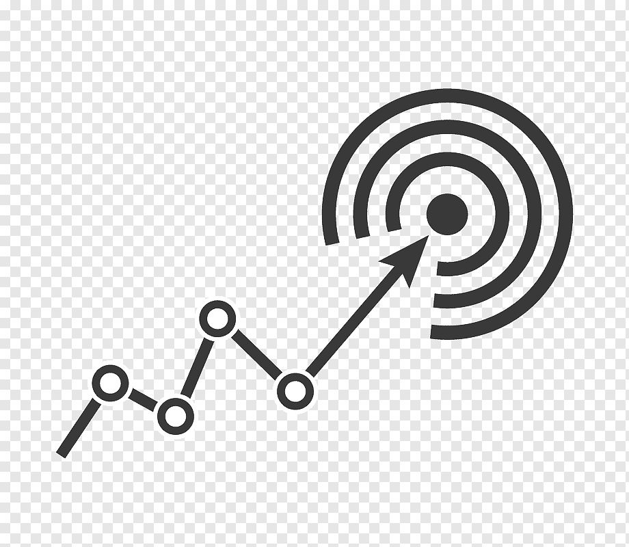
How does Machine Learning works
Training data
Accuracy
Training ML algorithm
Unacceptable
Acceptable
Model input data
Successfully model
New input data
ML algorithm
Prediction

Slide 33
How does Machine Learning works
A Machine Learning system learns from historical data, builds the prediction models, and whenever it receives new data, predicts the output for it. The accuracy of predicted output depends upon the amount of data, as the huge amount of data helps to build a better model which predicts the output more accurately.
Lear from data
Training
Machine learning algorithm
Building logical models
Output
Input data
New data

Slide 34
How does Machine Learning works
Suppose we have a complex problem, where we need to perform some predictions, so instead of writing a code for it, we just need to feed the data to generic algorithms, and with the help of these algorithms, machine builds the logic as per the data and predict the output. Machine learning has changed our way of thinking about the problem

Slide 35
Features of Machine Learning
Machine learning uses data to detect various patterns in a given dataset.
It can learn from past data and improve automatically.
It is a data-driven technology.
Machine learning is much similar to data mining as it also deals with the huge amount of the data.

Slide 36
The importance of Machine Learning
Rapid increment in the production of data
Solving complex problems, which are difficult for a human
Decision making in various sector including finance
Finding hidden patterns and extracting useful information from data.

Slide 37
Q&A
What is ML?

Slide 38
Q&A
How does Machine Learning works

Slide 39
Q&A
When to Use Machine Learning

Slide 40
Q&A
Why ML is important

Slide 41
Q&A
Where does ML fit in?

Slide 42
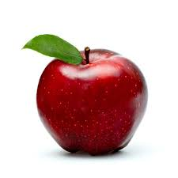
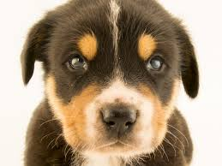
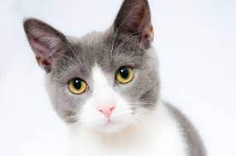
Quick terminology
Feature: Some aspect of the observation that we know. Could be a person’s hair color, the latitude and longitude of a city, or the number of rooms a house has. May be denoted as x
Label: The feature of an observation which we are trying to predict. For labelled observations, we already know the answer.
Color: red
Shape: circle
Type: fruit
Leafe: yes
Apple
Dog
cat

Slide 43

ML types
https://www.wordstream.com/blog/ws/2017/07/28/machine-learning-applications

Slide 44
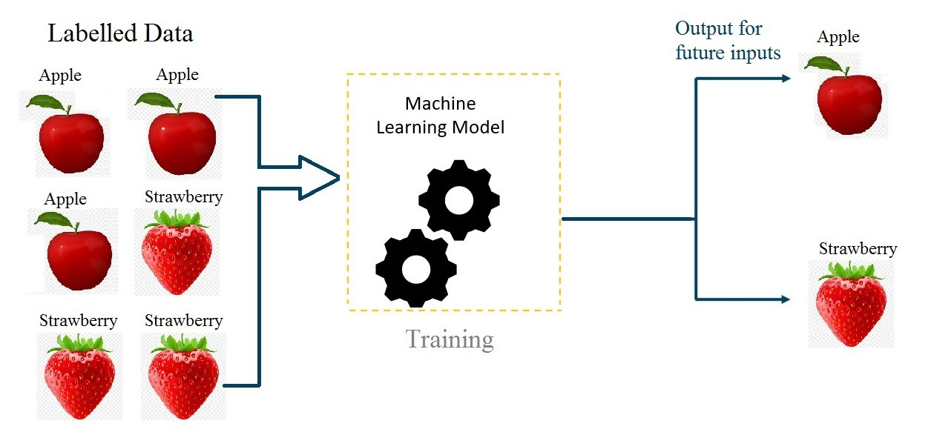
Supervised learning
We have a set of labeled training samples

Slide 45
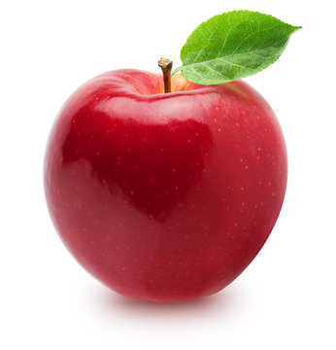
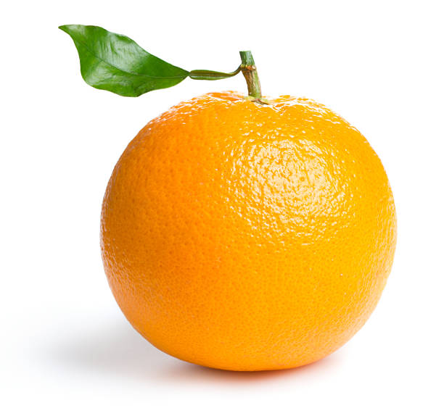
Supervised learning
Supervised Machine Learning is an algorithm that learns from labeled training data to predict outcomes for unforeseen data. In Supervised learning, train the machine using data that is well “labeled.”
Label 1: Apple
Label 2: Orange
Training
Model

Slide 46
Supervised learning
Supervised learning uses a training set to teach models to yield the desired output. This training dataset includes inputs and correct outputs, which allow the model to learn over time.
Supervised learning:
· Is simpler and more common than another learning types
· Is used when the human practitioner knows the answer, and wants to train the AI
· Classifies and processes data using machine language
· Uses labeled data (i.e. that which has been classified)

Slide 47
Supervised learning. Types
Supervised learning can be separated into two types of problems when data mining—classification and regression:
Classification uses an algorithm to accurately assign test data into specific categories. It recognizes specific entities within the dataset and attempts to draw some conclusions on how those entities should be labeled or defined.
Regression is used to understand the relationship between dependent and independent variables. It is commonly used to make projections, such as for sales revenue for a given business.

Slide 48
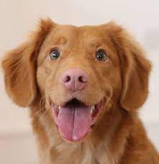
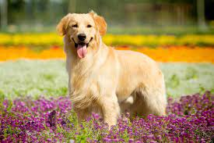
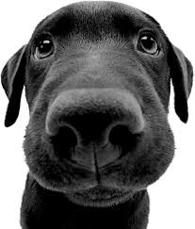
Classification
Cat
Input data
Dog

Slide 49

Regression
64 sm
66 sm
62 sm
60 sm
Age: 16
Hight: ?? sm
Age: 14
Hight: 66 sm
Age: 11
Hight: 62 sm
Age: 12
Hight: 64 sm
Age: 10
Hight: 60 sm

Slide 50
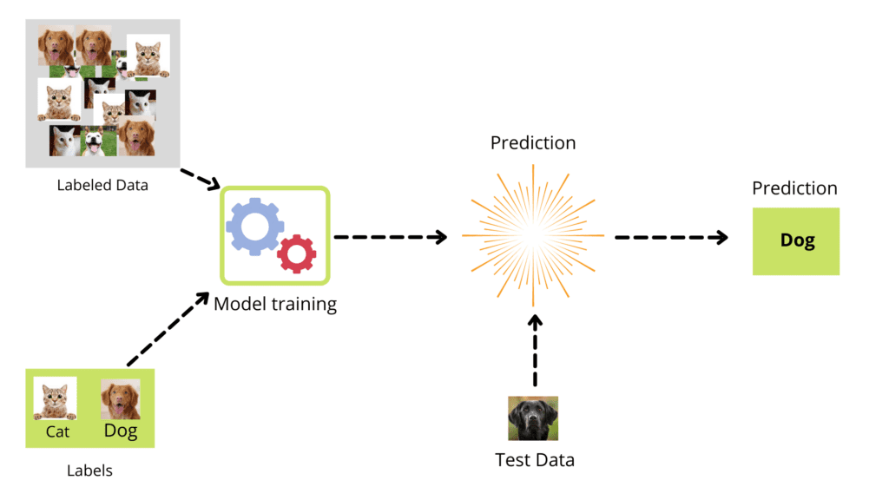
Supervised learning. Training
The training dataset steps:
Get data (labeled)
Clean, Prepare & Manipulate Data
Train Model
Test Model
Improve

Slide 51
Steps Involved in Supervised Learning
First Determine the type of training dataset
Collect/Gather the labelled training data.
Split the training dataset into training dataset, test dataset, and validation dataset.
Determine the input features of the training dataset, which should have enough knowledge so that the model can accurately predict the output.

Slide 52
Steps Involved in Supervised Learning
Determine the suitable algorithm for the model, such as support vector machine, decision tree, etc.
Execute the algorithm on the training dataset. Sometimes we need validation sets as the control parameters, which are the subset of training datasets.
Evaluate the accuracy of the model by providing the test set. If the model predicts the correct output, which means our model is accurate.

Slide 53
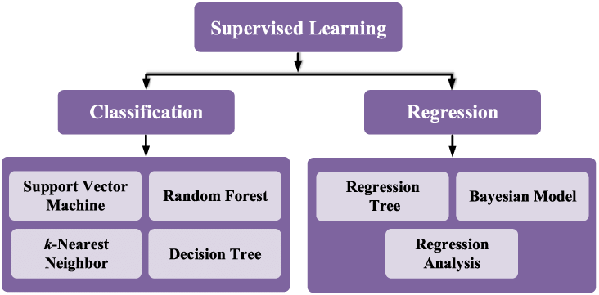
Supervised learning. Algorithms

Slide 54
Supervised learning. Advantages
Supervised learning allows collecting data and produces data output from previous experiences.
Helps to optimize performance criteria with the help of experience.
Supervised machine learning helps to solve various types of real-world computation problems.

Slide 55
Supervised learning. Disadvantages
Classifying big data can be challenging.
Training for supervised learning needs a lot of computation time. So, it requires a lot of time.
In supervised learning, we need enough knowledge about the classes of object.
Supervised learning cannot predict the correct output if the test data is different from the training dataset.

Slide 56
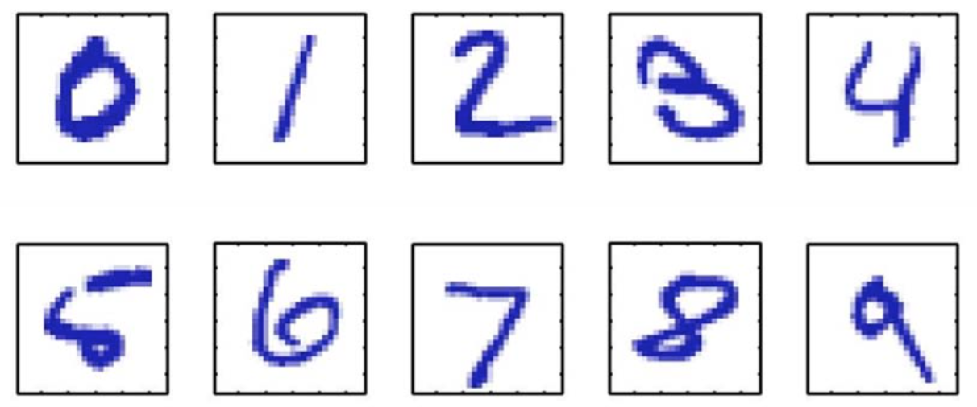
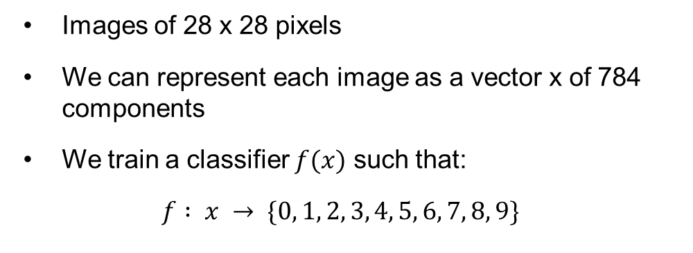
Supervised learning. Example
Handwritten digit recognition (on the MNIST data set)
Images of 28 x 28 pixels
We can represent each image as a vector x of 784 components
We train a classifier $f(x)$ such that:
$$f : x → \{0, 1, 2, 3, 4, 5, 6, 7, 8, 9\}$$

Slide 57
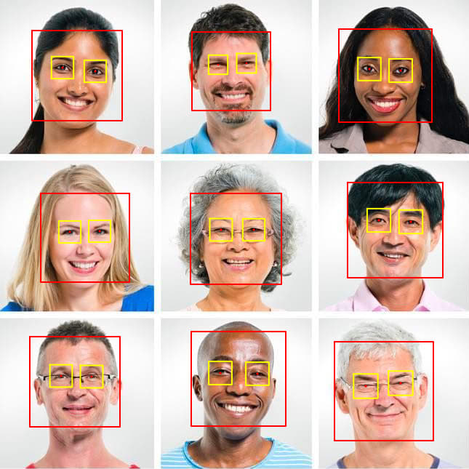
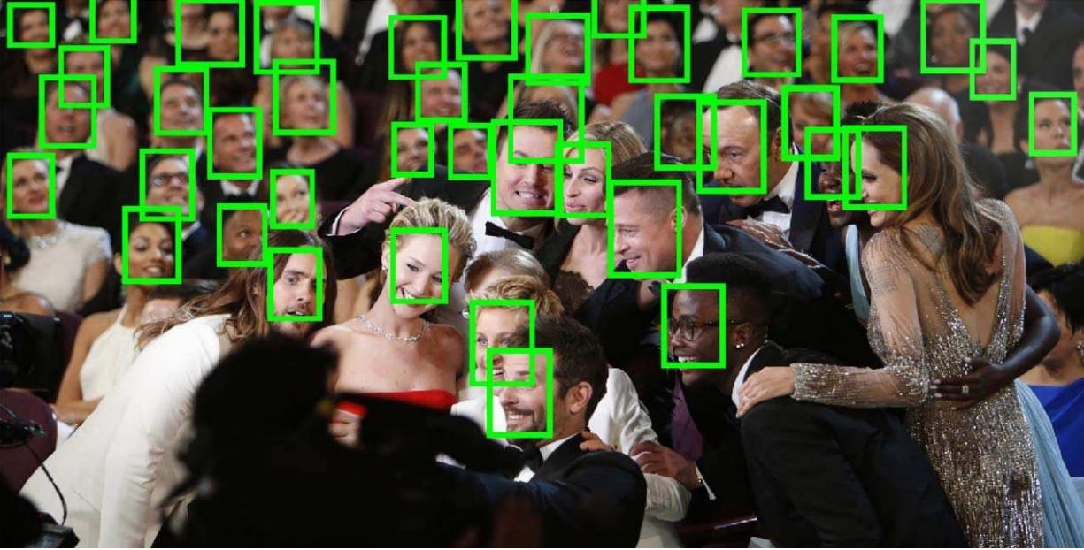
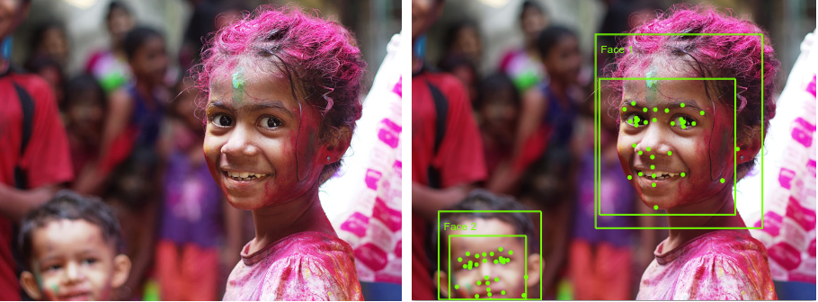
Supervised learning. Example
Face detection
One approach consists of sliding a window over the image
The goal is to classify each window into one of the two possible classes: face or not-face
The original problem is transformed into a classification problem

Slide 58
Limitations
Slow - it requires human experts to manually label training examples one by one.
Costly - a model should be trained on the large volumes of hand-labeled data to provide accurate predictions.

Slide 59
Q&A
What is Supervised Learning?

Slide 60
Q&A
The types of Supervised Learning

Slide 61
Q&A
Limitations of Supervised Learning

Slide 62
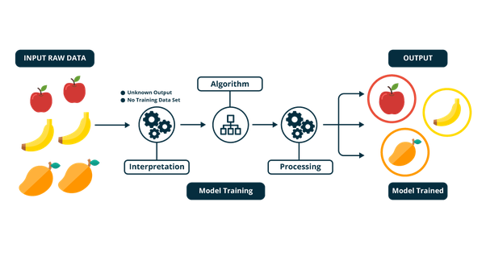
Unsupervised learning
We have a set of unlabeled training samples

Slide 63
Unsupervised learning
Unsupervised learning is a type of machine learning algorithm that looks for patterns in a dataset without pre-existing labels. Unsupervised learning does not rely on labels to identify patterns, the insights tend to be less biased than other forms of AI.
Training
Model

Slide 64
Unsupervised learning
Unsupervised learning is a type of machine learning in which models are trained using unlabeled dataset and are allowed to act on that data without any supervision.
Unsupervised machine learning finds all kind of unknown patterns in data.
Unsupervised methods help to find features which can be useful for categorization.
It is taken place in real time, so all the input data to be analyzed and labeled in the presence of learners.
It is easier to get unlabeled data from a computer than labeled data, which needs manual intervention.

Slide 65
Unsupervised learning. Types
Unsupervised learning can be separated into three:
Association rule mining
Clustering
Recommendation system

Slide 66
Clustering
Clustering: The clustering technique refers to grouping objects into clusters based on parameters such as similarities or differences between objects. For example, grouping customers by the products they purchase.
Input
Training
Model
Object similarity

Slide 67
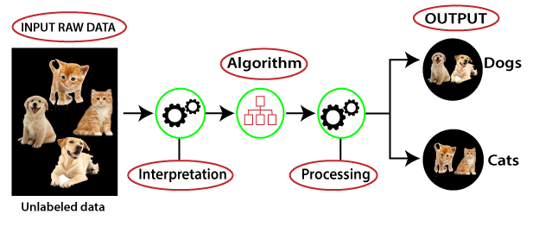
Unsupervised learning. Training
The training dataset steps:
Get data (unlabeled)
Clean, Prepare & Manipulate Data
Train Model
Test Model
Improve

Slide 68
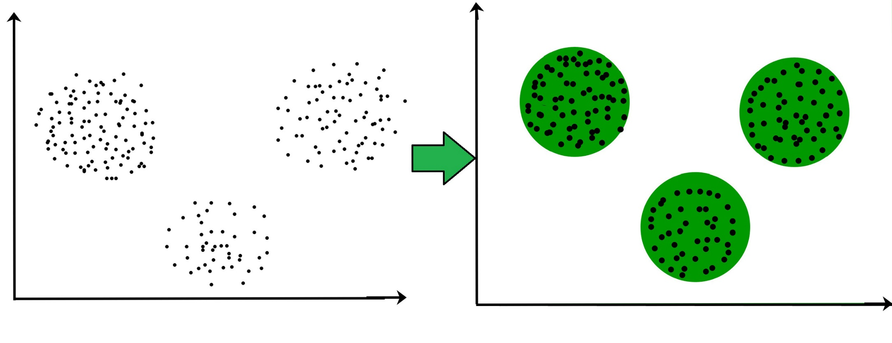
Unsupervised learning. Usage
Explore the structure of the information and detect distinct patterns.
Extract valuable insights.
Implement this into its operation in order to increase the efficiency of the decision-making process.

Slide 69
Applications of Unsupervised Learning
As the world’s data is increasing tremendously every day, unsupervised learning has many applications.
Grocery shop or e-commerce store/ marketplace:​ Extract Association rules from customers transactional data and recommendations for consumers to buy products.
Social media platform:​ Extract relationships with different users to suggest products or services. Recommend new people for social connect.
Services: ​Recommendations of travel services, a recommendation of houses to rent, or matchmaking services.
Banking:​ Cluster customers based on their financial transactions. Cluster fraudulent transaction for fraud detection.

Slide 70
Applications of Unsupervised Learning
Politics:​ Cluster voter’s opinions about chances of a win for a particular party.
Data visualization: With clustering and ​t-distributed Stochastic Neighbor​ Embedding​ (t-SNE), we can visualize high-dimensional data. Also, this can be used for dimensionality reduction.
Entertainment:​ Recommendations for movies, music, as Netflix and Amazon are doing.
Image segmentation:​ Cluster images portions based on nearest pixel values.
Content:​ personalized newspapers, recommendations of Web pages, e-learning applications, and email filters.
Structural discovery: With clustering, we can discover any hidden structure in the data—cluster twitter data for sentiment analysis.

Slide 71
Advantages of Unsupervised Learning
Unsupervised learning is used for more complex tasks as compared to supervised learning because, in unsupervised learning, we don't have labeled input data.
Unsupervised learning is preferable as it is easy to get unlabeled data in comparison to labeled data.

Slide 72
Disadvantages of Unsupervised Learning
Unsupervised learning is intrinsically more difficult than supervised learning as it does not have corresponding output.
The result of the unsupervised learning algorithm might be less accurate as input data is not labeled, and algorithms do not know the exact output in advance.

Slide 73


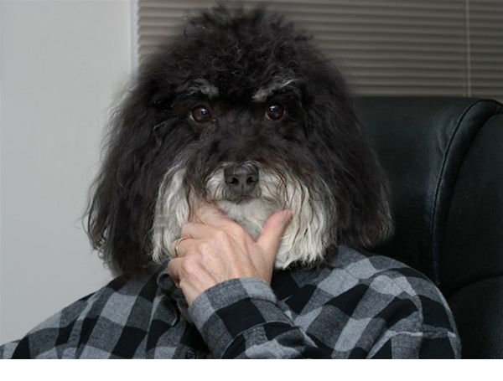
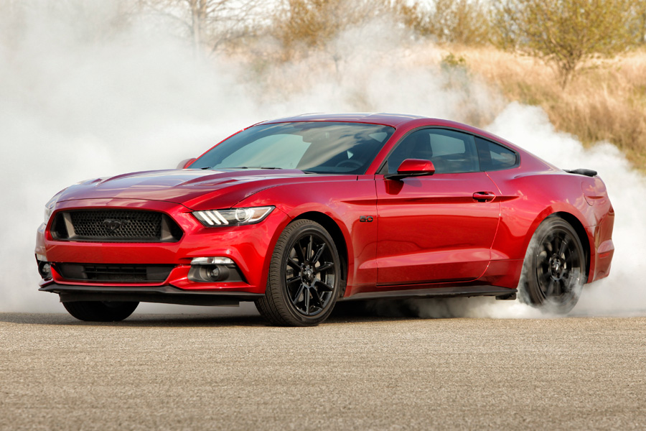
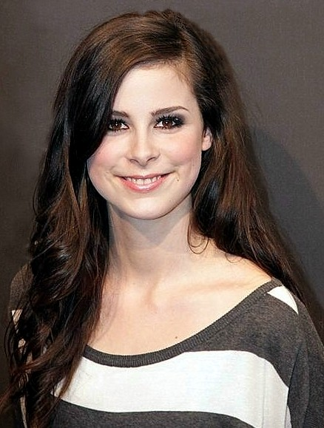
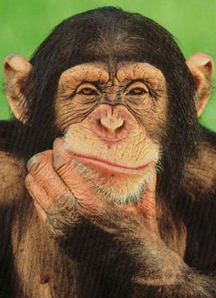
Unsupervised Learning. Example
We have an unlabeled training set of samples
Example 1: clustering images based on similarity

Slide 74
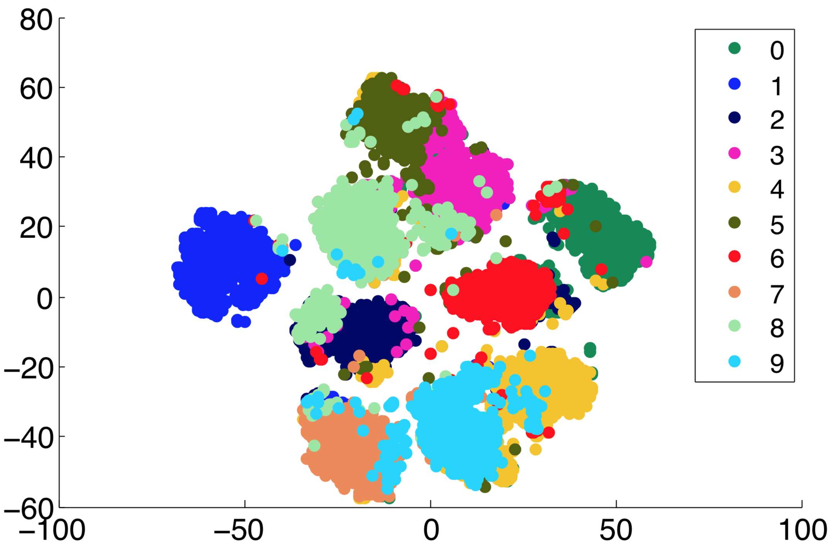
Unsupervised Learning. Example
Clustering MNIST images based on similarity

Slide 75
Unsupervised learning
Example 2: unsupervised features learning

Slide 76
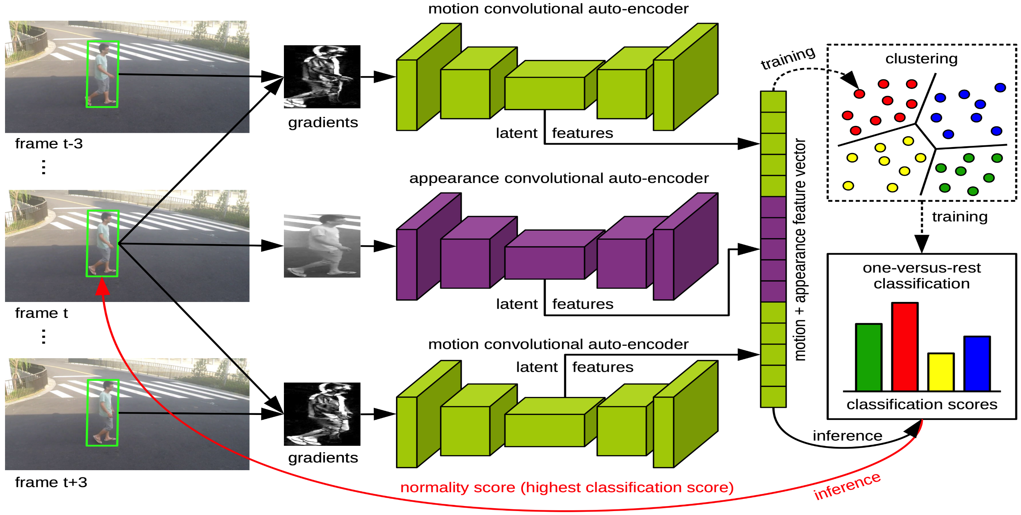
Unsupervised learning
Example 2: unsupervised features learning for abnormal event detection [Ionescu et al. CVPR2019]

Slide 77
Unsupervised learning models
K-means clustering
DBScan
Hierarchical clustering
Principal Component Analysis
t-Distributed Stochastic Neighbor Embedding
Hidden Markov Models
Many others…

Slide 78
Limitations
Has a limited area of applications (mostly for clustering purposes).

Slide 79
Q&A
What is Unsupervised Learning?

Slide 80
Q&A
The types of Unsupervised Learning

Slide 81
Q&A
Limitations of Unsupervised Learning

Slide 82
Differences between supervised and unsupervised
Supervised Learning | Unsupervised Learning
Supervised learning algorithms are trained using labeled data. | Unsupervised learning algorithms are trained using unlabeled data.
Supervised learning model takes direct feedback to check if it is predicting correct output or not. | Unsupervised learning model does not take any feedback.
Supervised learning model predicts the output. | Unsupervised learning model finds the hidden patterns in data.
In supervised learning, input data is provided to the model along with the output. | In unsupervised learning, only input data is provided to the model.
The goal of supervised learning is to train the model so that it can predict the output when it is given new data. | The goal of unsupervised learning is to find the hidden patterns and useful insights from the unknown dataset.

Slide 83
Differences between supervised and unsupervised
Supervised Learning | Unsupervised Learning
Supervised learning needs supervision to train the model. | Unsupervised learning does not need any supervision to train the model.
Supervised learning can be categorized in Classification and Regression problems. | Unsupervised Learning can be classified in Clustering and Associations problems.
Supervised learning model produces an accurate result. | Unsupervised learning model may give less accurate result as compared to supervised learning.
Supervised learning is not close to true Artificial intelligence as in this, we first train the model for each data, and then only it can predict the correct output. | Unsupervised learning is more close to the true Artificial Intelligence as it learns similarly as a child learns daily routine things by his experiences.

Slide 84
Semi-supervised learning
Training dataset
All data is labeled
Model
Supervised learning
All data is unlabeled
Model
Unsupervised learning
Small portion of data is labeled
?
Model
Lots of data is unlabeled

Slide 85
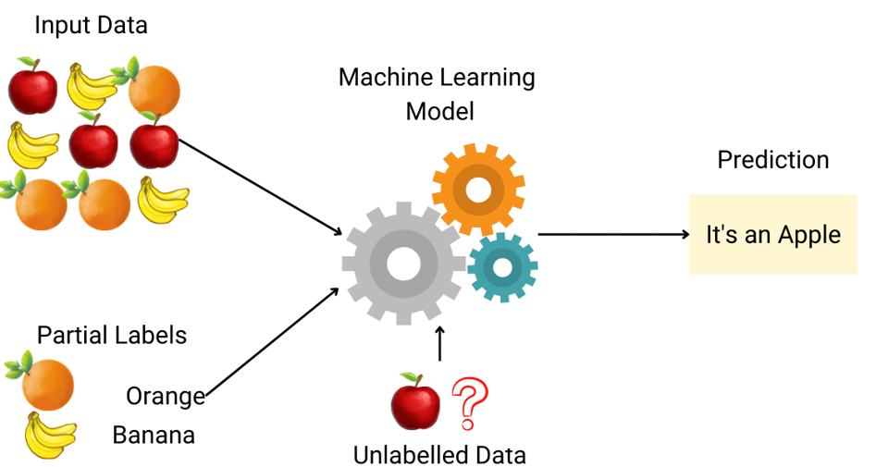

Semi-supervised learning
Semi-Supervised learning is a type of Machine Learning algorithm that represents the intermediate ground between Supervised and Unsupervised learning algorithms. It uses the combination of labeled and unlabeled datasets during the training period.

Slide 86
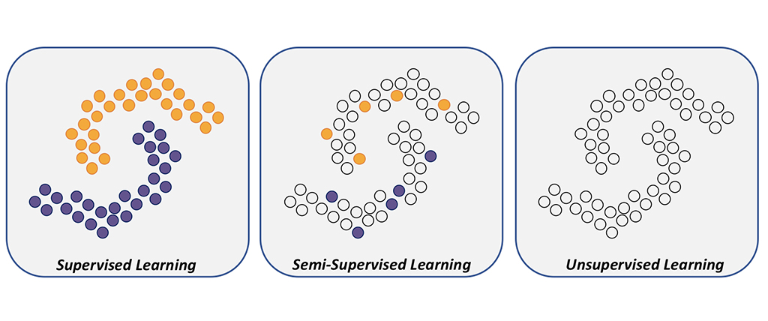
Semi-supervised learning

Slide 87
Semi-supervised learning self- training method. Step 1
A small portion of data with human – made labels
First classifier
Pick a small amount of labeled data, e.g., images showing cats and dogs with their respective tags, and use dataset to train a base model with the help of ordinary supervised methods

Slide 88
Semi-supervised learning self- training method. Step 2
A lots of unlabeled data
First classifier trained on labeled data
Make prediction →Pseudo - labels
Then applied the process known as pseudo-labeling — when take the partially trained model and use it to make predictions for the rest of the database which is yet unlabeled. The labels generated thereafter are called pseudo as they are produced based on the originally labeled data that has limitations.

Slide 89
Semi-supervised learning self- training method. Step 3
Original labeled data
New data
Improved classifier trained on new dataset
Predictions
Most confident pseudo-labels
From this point, the most confident predictions made with model (for example, if the confidence of over 80 percent that a certain image shows a cat, not a dog). If any of the pseudo-labels exceed this confidence level, will be added into the labeled dataset and create a new, combined input to train an improved model.

Slide 90
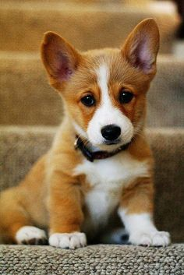
Semi-supervised learning. Example
Example 1: object recognition in images, some of which are annotated with corresponding class labels
Car
Dog
Person

Slide 91
Q&A
What is Semi-Supervised Learning?

Slide 92
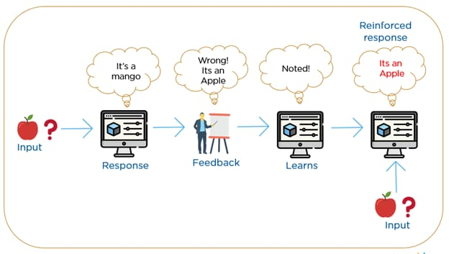
Reinforcement learning
Reinforcement Learning is a feedback-based Machine learning technique in which an agent learns to behave in an environment by performing the actions and seeing the results of actions. For each good action, the agent gets positive feedback, and for each bad action, the agent gets negative feedback or penalty.

Slide 93
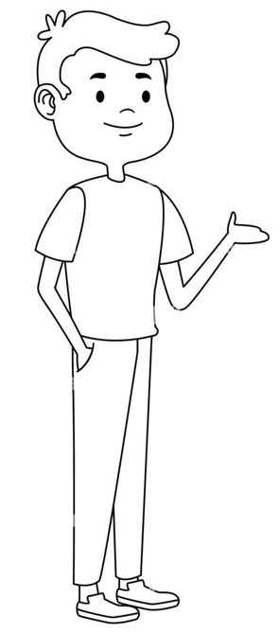

Reinforcement learning
Agent
Feedback
Action. Calculation method 1: 5
2*2 = ?
Action. Calculation method 2: 3
Action. Calculation method 3: 4

Slide 94
Reinforcement learning
In Reinforcement Learning, the agent learns automatically using feedbacks without any labeled data, unlike supervised learning.
Since there is no labeled data, so the agent is bound to learn by its experience only.
RL solves a specific type of problem where decision making is sequential, and the goal is long-term, such as game-playing, robotics, etc.
The agent interacts with the environment and explores it by itself. The primary goal of an agent in reinforcement learning is to improve the performance by getting the maximum positive rewards.

Slide 95
Reinforcement learning
The agent learns with the process of hit and trial, and based on the experience, it learns to perform the task in a better way. Hence, we can say that "Reinforcement learning is a type of machine learning method where an intelligent agent (computer program) interacts with the environment and learns to act within that."
How a Robotic dog learns the movement of his arms is an example of Reinforcement learning.
It is a core part of Artificial intelligence, and all AI agent works on the concept of reinforcement learning. Here we do not need to pre-program the agent, as it learns from its own experience without any human intervention.

Slide 96
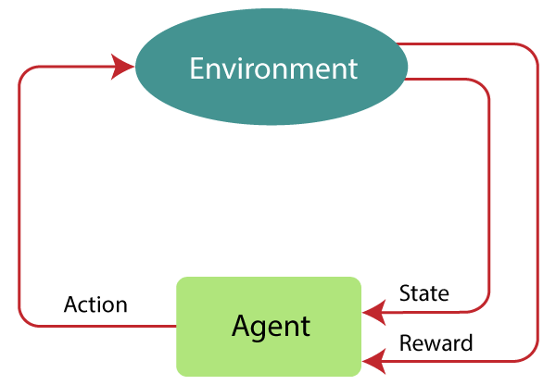
Reinforcement learning. Working steps
The agent continues doing these three things (take action, change state/remain in the same state, and get feedback), and by doing these actions, he learns and explores the environment.
The agent learns that what actions lead to positive feedback or rewards and what actions lead to negative feedback penalty. As a positive reward, the agent gets a positive point, and as a penalty, it gets a negative point.

Slide 97


Reinforcement learning. Example
Case # 1: There is a baby in the family, and she has just started walking, and everyone is quite happy about it. So one day, the parents try to set a goal, let us baby reach the couch, and see if the baby is able to do so.
Result of Case 1: The baby successfully reaches the set, and thus everyone in the family is very happy to see this. The chosen path now comes with a positive reward.
Points: Reward + (+n) → Positive reward.

Slide 98
Reinforcement learning. Example
Case # 2: The baby was not able to reach the couch, and the baby has fallen. It hurts! What possibly could be the reason? There might be some obstacles in the path to the couch, and the baby had fallen to obstacles.
Result of Case 2: The baby falls to some obstacles, and she cries! Oh, that was bad, she learned, not to fall into the trap of obstacle the next time. The chosen path now comes with a negative reward.
Points: Rewards + (-n) →Negative reward.

Slide 99
Q&A
What are the different types of Machine Learning?

Slide 100
Q&A
What is Reinforcement learning?

Slide 101
Q&A
What is the main difference between supervised and unsupervised learning?

Slide 102
Q&A
What is differences of Reinforcement learning and unsupervised learning

Slide 103
Steps to solve ML problems
Dataset gathering
Dataset pre-processing
Feature engineering
Algorithm selection & Training
Making prediction

Slide 104
Dataset gathering
Might depend on human work
Manual labeling for supervised learning.
Domain knowledge. Maybe even experts.
May come for free, or “sort of”
• E.g., Machine Translation.
The more the better: Some algorithms need large amounts of data to be useful (e.g., neural networks).
The quantity and quality of data dictate the model accuracy

Slide 105
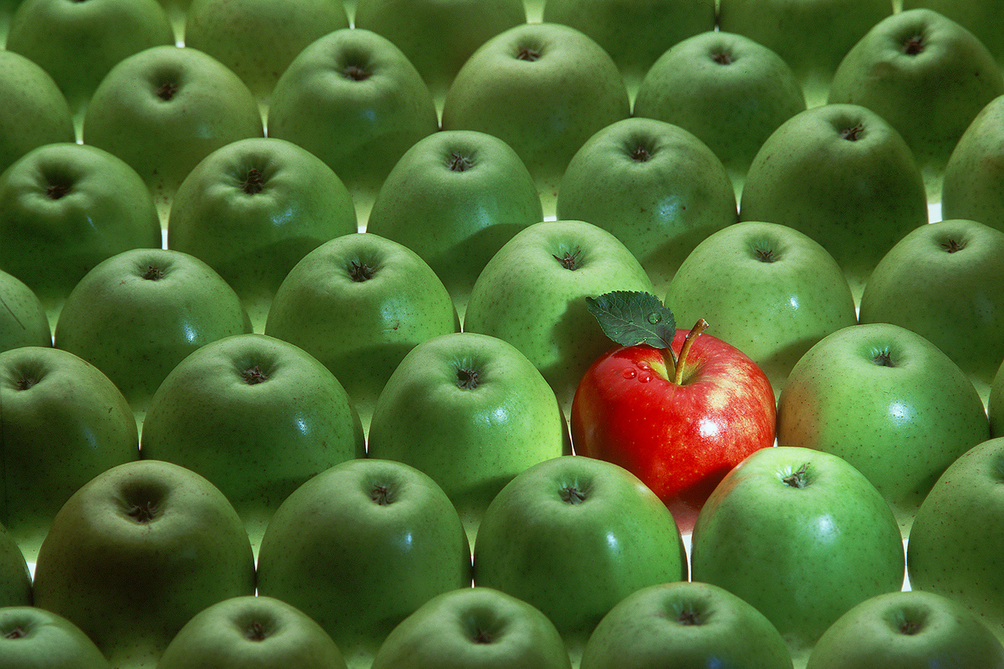
Dataset pre-processing
Is there anything wrong with the data?
Missing values
Outliers
Bad encoding (for text)
Wrongly-labeled examples
Biased data
Do I have many more samples of one class than the rest?
Need to fix/remove data?

Slide 106
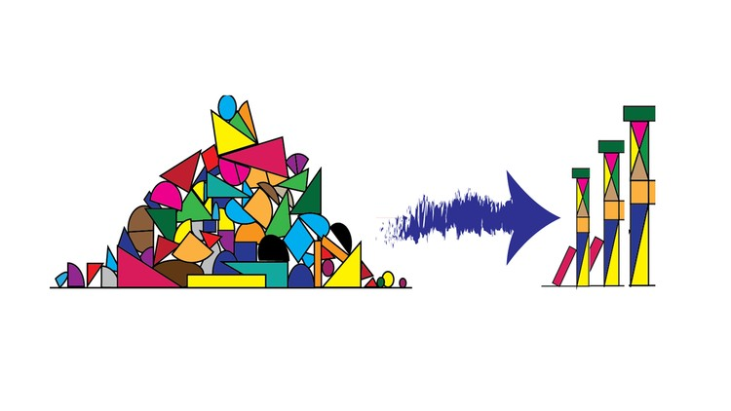
Feature engineering
What is a feature?
A feature is an individual measurable property of a phenomenon being observed
Our inputs are represented by a set of features.
Extract more information from existing data, not adding “new” data per-se
Making it more useful
With good features, most algorithms can learn faster
Requires thought and knowledge of the data Two steps:
Variable transformation (e.g., dates into weekdays, normalizing)
Feature creation (e.g., n-grams for texts, if word is capitalized to detect names, etc.)

Slide 107
Algorithm selection
Supervised Unsupervised
Linear classifier PCA
Naive Bayes t-SNE
Support Vector Machines (SVM) k-means
Decision Tree DBSCAN
Random Forests
k-Nearest Neighbors
Neural Networks (Deep learning)

Slide 108
Training
Training a machine learning (ML) model is a process in which a machine learning algorithm is fed with training data from which it can learn.
Goal of training: making the correct prediction as often as possible

Slide 109
Making prediction
train
Label: Cat
ML model
Features
Feature extraction
Features
Features
Features
ML model
Input
p
r
e
d
i
c
t
Feature extraction
Features
Output label

Slide 110
Questions: sabinatuit@gachon.ac.kr

Slide 111
Next time
Linear regression
Logistic regression

